Slide 1


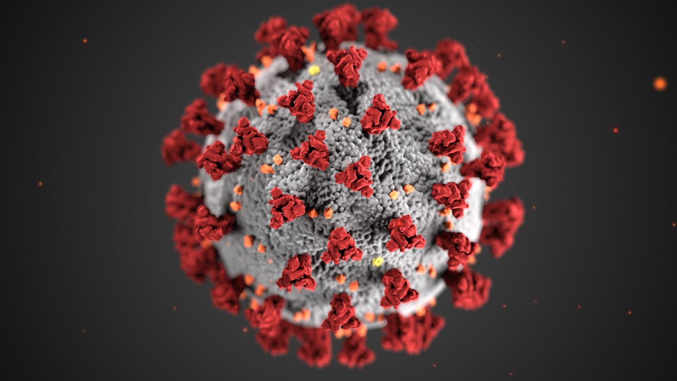

DE15 Report Presentation
George
Kate
Joao
Ross
Chris

Slide 2
Intent of our report
Impact of Covid on hospitalizations
Impact of Covid on demographics
General trend of consequent admissions
Representation in Shiny dashboard

Slide 3
Hospitalisations

Slide 4
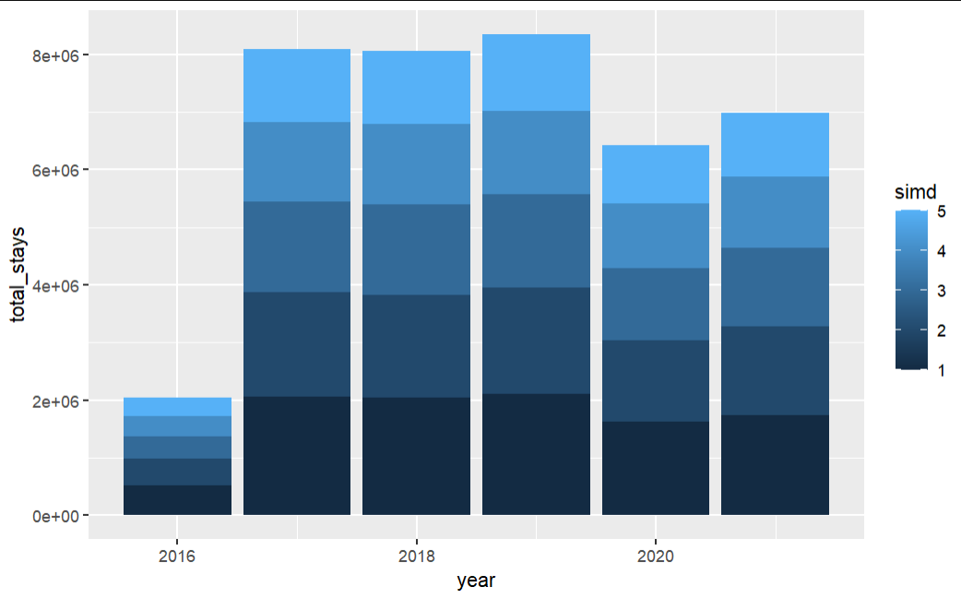
Impact on Demographics

Slide 5
Map of Impact

Slide 6
Temporal data

Slide 7
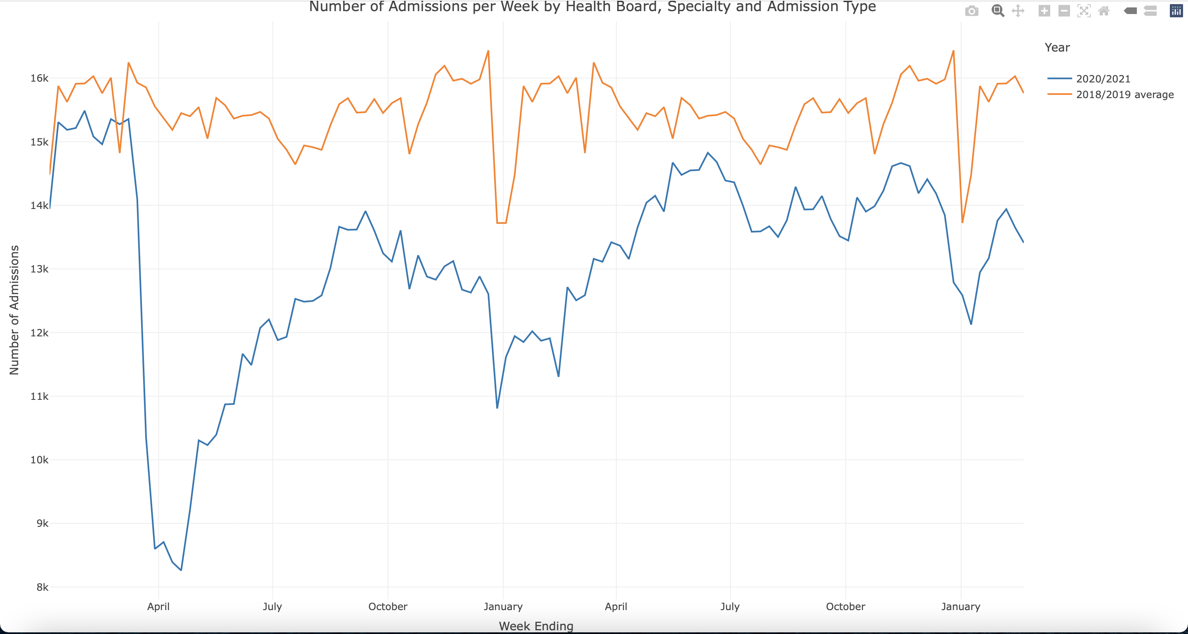
Trend of Admissions

Slide 8
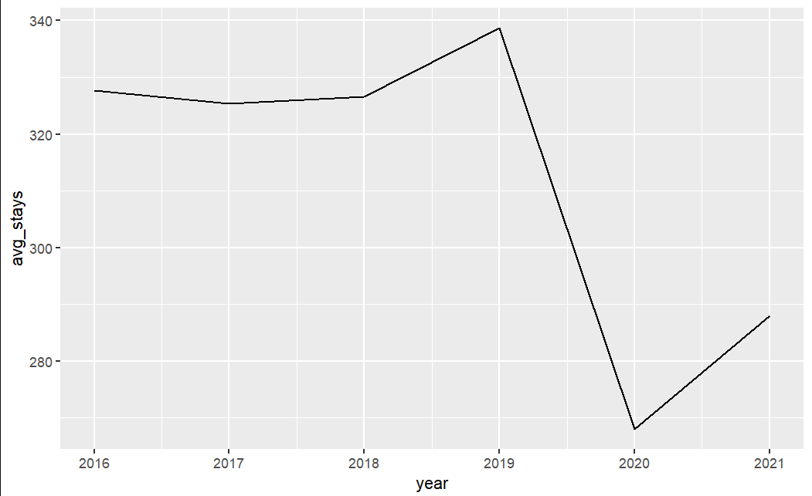
Trend of stays

Slide 9
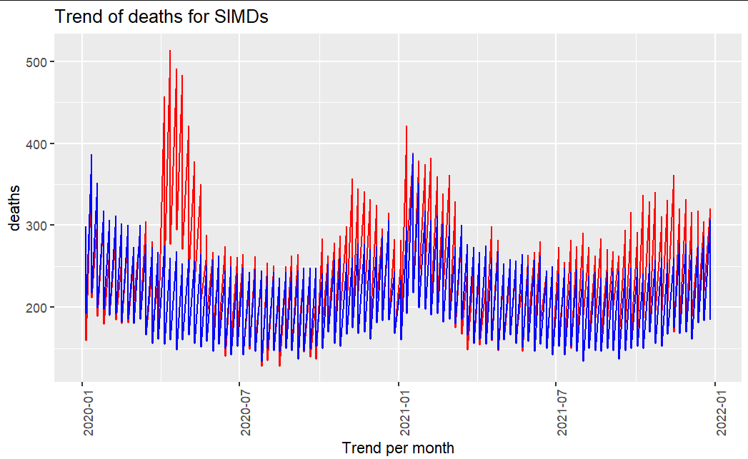
Trend of deaths
Average death trend from 2015 to 2019
Average death trend from January 2020 onwards

Slide 10
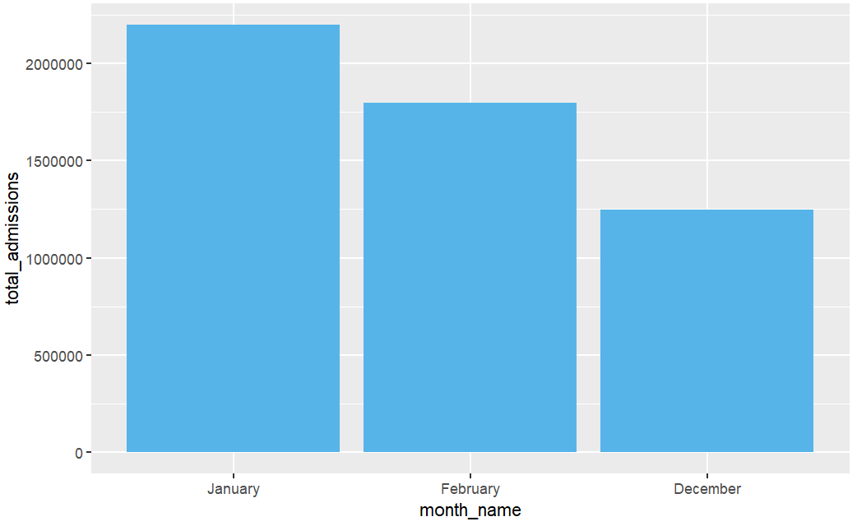
Impact of Winter

Slide 11
Shiny Dashboard

Slide 12
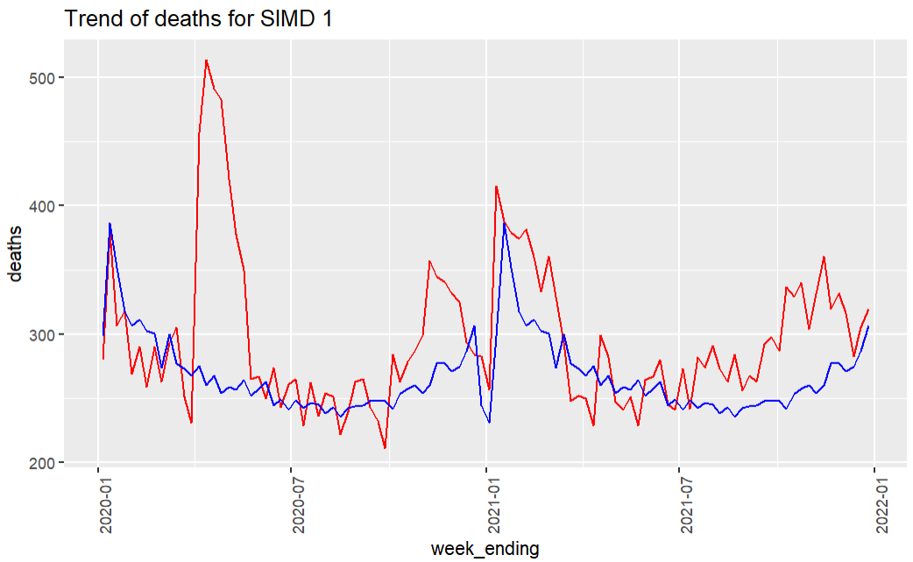
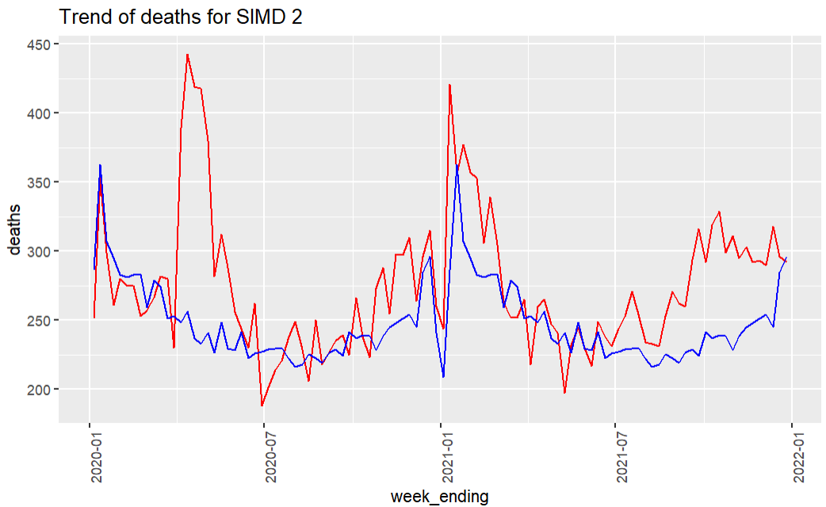
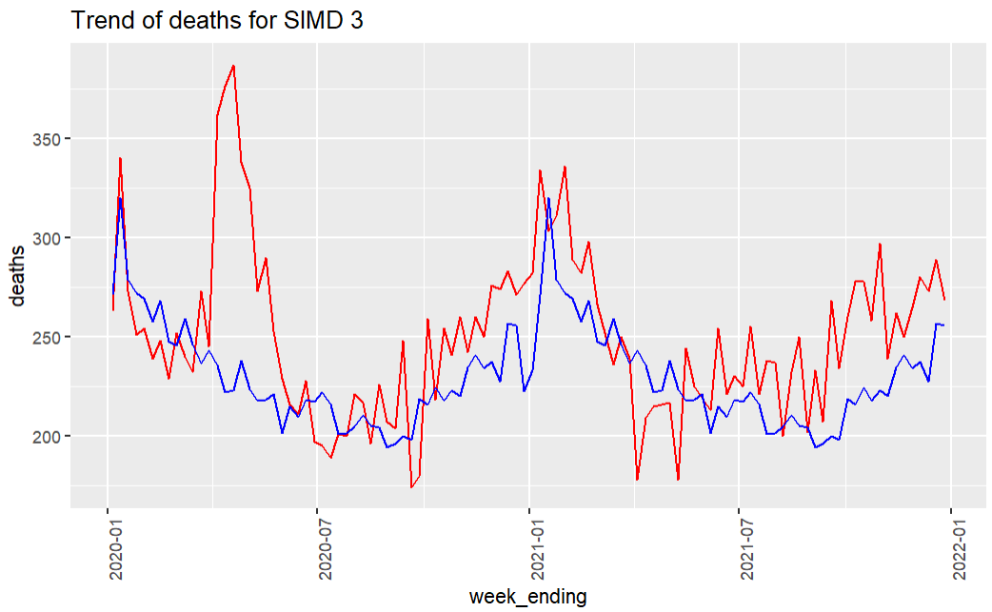
Deprivation

Slide 13
Conclusion
We are proposing that this 5% of the overall patients return home after their treatment each day as the other 95% of patients do, returning to the CIC for further treatment or assessment the next day

